Slide 1
Alpha Omega • Henry Schein Cares
Holocaust Survivors Oral Health Program

Slide 2
Overview
Lack of access to oral care is a major issue for Holocaust survivors:
25% of survivors live under the poverty line in the U.S vs. 9% general population in the same age group.
Many survivors were young children during World War II, and prolonged nutritional deprivation and lack of any dental care in their youth has significantly impacted their oral health.
Many survivors suffer from dental pain, disruption of function (ability to eat properly, etc.), and lack insurance coverage.

Slide 3
Overview – White House’s Call to Action
In December 2013, Vice President Biden announced a White House initiative to promote the development of innovative public-private partnerships to support the needs of Holocaust survivors living in the U.S.
As part of this effort, the Administration appointed the first ever Special Envoy for U.S. Holocaust Survivor Services, Aviva Sufian.

Slide 4
Answering the Call to Action
Alpha Omega International Dental Fraternity and Henry Schein, Inc. answered the White House call to action, and developed the Alpha Omega-Henry Schein Cares Holocaust Survivors Oral Health Program.
The Program provides pro-bono care to the most economically vulnerable Holocaust survivors, as well as individuals of any faith who are survivors of Nazi persecution and meet the eligibility requirements of the program.
Elimination of pain
Restoring function
Lack of dental coverage

Slide 5
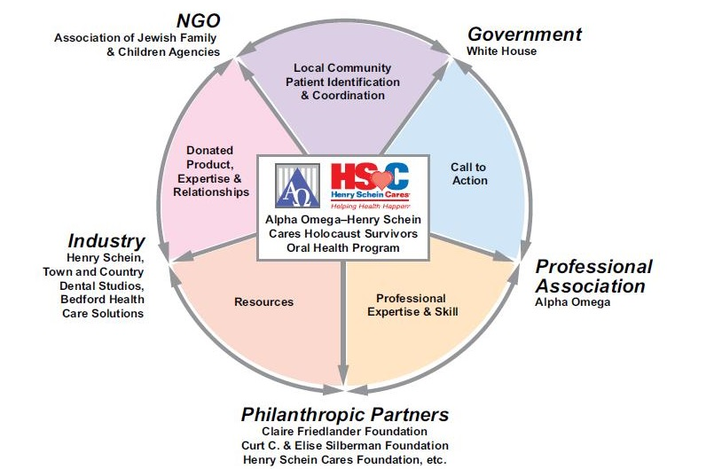
An Exemplary Public-Private Partnership

Slide 6
Highlights
Quick facts about the program:
First launched in January 2015 in nine cities – New York City, the New York/New Jersey metropolitan area, Boston, Chicago, Philadelphia, Detroit, Seattle, Montreal, and Toronto
Expanded during 2015 to include three additional cities – Atlanta, Columbus, and Calgary
Expansion planned for 2016 to additional cities and two dental schools.

Slide 7
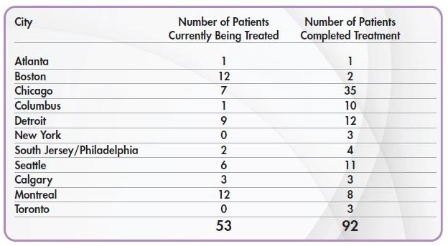
Results
In the first year of the program, more than 145 economically vulnerable Holocaust survivors received necessary, free dental care valued at more than $500,000.

Slide 8
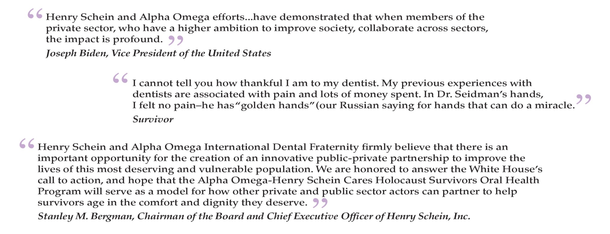
Impact

Slide 9
Results
The Blue Card’s Max L. Humanitarian Award
PR News’ 2015 CSR Award
Commendation from Chicago Mayor Rahm Emanuel
Proclamation by Seattle Mayor Edward Murray
2015 Janice B. Ballas Community Service Award

Slide 10
Lesson Learned
Scaling up a new public – private partnership initiative inherently has many moving parts →
Must crawl…walk…then run…

